Slide 1
Business Review AO – CHENNAI Nov’ 22

Slide 2
Month Sales –Offtake

Slide 3
Month Sales – Retail

Slide 4
ICV

Slide 5
ICV Goods

Slide 6
ICV Goods- 10T

Slide 7
ICV Goods- 12T

Slide 8
ICV Goods- 15T

Slide 9
Bucket Analysis – ICV
Nov' 22
SL NO | BRANCH | BUCKET STATUS |  |  |  |  |  |  |  |  |  | TOTAL TIV | CUM MS | MC outlet wise
 |  | Lost but not found | Lost and Found | Delayed Known | Fought and Lost |  |  |  |  |  | B5 [AL]
 |  |  |  |  | COMP LOYAL | Service | PRODUCT | PRICE | Finance | B4 TOTAL
1 | TVS PME 1 | 25 | 10 | 0 | 2 | 0 | 0 | 8 | 0 | 10 | 24 | 69 | 35% | 49%
2 | TVS MADHAVARAM | 24 | 9 | 0 | 1 | 0 | 0 | 0 | 0 | 1 | 9 | 43 | 21% | 23%
3 | TVS PADAPPAI | 6 | 7 | 0 | 1 | 0 | 0 | 4 | 0 | 5 | 5 | 23 | 22% | 43%
4 | TVS VELLORE | 3 | 7 | 0 | 6 | 0 | 0 | 0 | 0 | 6 | 2 | 18 | 11% | 44%
5 | TVS VILLUPURAM | 17 | 2 | 0 | 1 | 0 | 0 | 0 | 0 | 1 | 6 | 26 | 23% | 27%
6 | TVS PONDY | 4 | 1 | 0 | 0 | 0 | 0 | 0 | 0 | 0 | 2 | 7 | 29% | 29%
7 | TVS TV MALAI | 5 | 1 | 0 | 0 | 0 | 0 | 2 | 0 | 2 | 3 | 11 | 27% | 45%
TOTAL |  | 84 | 37 | 0 | 11 | 0 | 0 | 14 | 0 | 25 | 51 | 197 | 26% | 39%
PERCENTAGE |  | 43% | 19% | 0% |  |  |  |  |  | 13% | 26%
Cum Nov' 22
SL NO | BRANCH | BUCKET STATUS |  |  |  |  |  |  |  |  |  | TOTAL TIV | CUM MS | MC outlet wise
 |  | Lost but not found | Lost and Found | Delayed Known | Fought and Lost |  |  |  |  |  | B5 [AL]
 |  |  |  |  | COMP LOYAL | Service | PRODUCT | PRICE | Finance | B4 TOTAL
1 | TVS PME 1 | 310 | 107 | 0 | 109 | 6 | 1 | 46 | 10 | 172 | 197 | 786 | 25% | 47%
2 | TVS MADHAVARAM | 337 | 59 | 0 | 34 | 0 | 1 | 58 | 8 | 101 | 93 | 590 | 16% | 33%
3 | TVS PADAPPAI | 193 | 118 | 0 | 26 | 0 | 0 | 38 | 0 | 64 | 53 | 428 | 12% | 27%
4 | TVS VELLORE | 48 | 36 | 0 | 53 | 0 | 0 | 17 | 3 | 73 | 70 | 227 | 31% | 63%
5 | TVS VILLUPURAM | 84 | 5 | 0 | 21 | 0 | 0 | 3 | 1 | 25 | 48 | 162 | 30% | 45%
6 | TVS PONDY | 10 | 1 | 0 | 9 | 0 | 0 | 11 | 0 | 20 | 26 | 57 | 46% | 81%
7 | TVS TV MALAI | 14 | 5 | 0 | 1 | 0 | 0 | 8 | 1 | 10 | 23 | 52 | 44% | 63%
TOTAL |  | 996 | 331 | 0 | 253 |  | 2 | 181 | 23 | 465 | 510 | 2302 | 22% | 42%
PERCENTAGE |  | 43% | 14% | 0% |  |  |  |  |  | 20% | 22%

Slide 10
Buses

Slide 11
MDV Passenger

Slide 12
ICV Passenger

Slide 13
Heat Map – Buses FY 21-22
Segment | Poonamalle |  |  | Madhavaram |  |  | Padappai |  |  | Vellore |  |  | Villupuram |  |  | Pondicherry |  |  | AO Chennai
MDV Bus | 95.9 |  |  | 0.0 |  |  | 1.8 |  |  | 2.4 |  |  | 0.0 |  |  | 0.0 |  |  | 100.0
 | 84.0 |  |  | 0.0 |  |  | 100.0 |  |  | 25.0 |  |  | 0.0 |  |  | 0.0 |  |  | 82.8
 |  |  | 47.2 |  |  | #DIV/0! |  |  | 33.3 |  |  | 14.3 |  |  | 0.0 |  |  | 0.0 |  |  | 100.0
ICV Bus | 81.9 |  |  | 0.0 |  |  | 2.7 |  |  | 10.9 |  |  | 3.2 |  |  | 1.4 |  |  | 100.0
 | 19.3 |  |  | 0.0 |  |  | 0.0 |  |  | 50.0 |  |  | 28.6 |  |  | 33.3 |  |  | 22.6
 |  |  | 52.8 |  |  | #DIV/0! |  |  | 66.7 |  |  | 85.7 |  |  | 100.0 |  |  | 100.0 |  |  | 100.0
Bus Total | 87.9 |  |  | 0.0 |  |  | 2.3 |  |  | 7.2 |  |  | 1.8 |  |  | 0.8 |  |  | 100.0
 | 49.9 |  |  | 0.0 |  |  | 33.3 |  |  | 46.4 |  |  | 28.6 |  |  | 33.3 |  |  | 48.7
 |  |  | 100.0 |  |  | #DIV/0! |  |  | 100.0 |  |  | 100.0 |  |  | 100.0 |  |  | 100.0 |  |  | 100.0

Slide 14
Heat Map – Buses YTD FY 22-23
Segment | Poonamalle |  |  | Madhavaram |  |  | Padappai |  |  | Vellore |  |  | Villupuram |  |  | Pondicherry |  |  | AO Chennai
MDV | 90.8 |  |  | 0.0 |  |  | 0.4 |  |  | 5.7 |  |  | 1.3 |  |  | 1.8 |  |  | 100.0
 | 73.0 |  |  | 0.0 |  |  | 100.0 |  |  | 84.6 |  |  | 100.0 |  |  | 100.0 |  |  | 74.6
 |  |  | 49.9 |  |  | 0.0 |  |  | 9.1 |  |  | 28.6 |  |  | 11.5 |  |  | 80.0 |  |  | 100.0
ICV | 75.4 |  |  | 0.5 |  |  | 3.6 |  |  | 11.8 |  |  | 8.3 |  |  | 0.4 |  |  | 100.0
 | 42.4 |  |  | 0.0 |  |  | 90.0 |  |  | 43.1 |  |  | 19.6 |  |  | 100.0 |  |  | 42.3
 |  |  | 50.1 |  |  | 100.0 |  |  | 90.9 |  |  | 71.4 |  |  | 88.5 |  |  | 20.0 |  |  | 100.0
Bus Total | 82.4 |  |  | 0.3 |  |  | 2.2 |  |  | 9.0 |  |  | 5.1 |  |  | 1.0 |  |  | 100.0
 | 57.7 |  |  | 0.0 |  |  | 90.9 |  |  | 54.9 |  |  | 28.8 |  |  | 100.0 |  |  | 56.9
 |  |  | 100.0 |  |  | 100.0 |  |  | 100.0 |  |  | 100.0 |  |  | 100.0 |  |  | 100.0 |  |  | 100.0

Slide 15
Bucket Analysis - Buses
Nov 22 MDV & ICV Buses
SL NO | BRANCH | BUCKET STATUS |  |  |  |  |  |  |  |  |  |  | TOTAL TIV | MS | Market Coverage
 |  | B1 | B2 | B3 | B4 |  |  |  |  |  |  | B5 [AL]
 |  |  |  |  | COMP LOYAL | DRIVER PREFERENCE | EMOTIONAL | FINANCE | PRODUCT | PRICE | B4 TOTAL
1 | TVS PME |  | 12 |  |  |  |  |  |  | 14 | 14 | 155 | 181 | 86% | 93%
2 | TVS MADHAVARAM |  |  |  |  |  |  |  |  |  |  |  | 0 | #DIV/0! | #DIV/0!
3 | TVS PADAPPAI |  |  |  |  |  |  |  |  |  |  |  | 0 | #DIV/0! | #DIV/0!
4 | TVS VELLORE |  |  |  |  |  |  |  |  | 1 | 1 | 3 | 4 | 75% | 100%
5 | TVS TV MALAI |  |  |  |  |  |  |  |  |  |  |  | 0 | #DIV/0! | #DIV/0!
6 | TVS VILLUPURAM | 3 |  |  |  |  |  |  |  |  |  | 2 | 5 | 40% | 40%
7 | TVS PONDY |  |  |  |  |  |  |  |  |  |  | 3 | 3 | 100% | 100%
TOTAL |  | 3 | 12 | 0 | 0 | 0 | 0 | 0 | 0 | 15 | 15 | 163 | 193 | 84% | 92%
PERCENTAGE |  | 2% | 6% | 0% |  |  |  |  |  |  | 8% | 84%
Cum Nov'22 MDV & ICV Buses
SL NO | BRANCH | BUCKET STATUS |  |  |  |  |  |  |  |  |  |  | TOTAL TIV | MS | Market Coverage
 |  | B1 | B2 | B3 | B4 |  |  |  |  |  |  | B5 [AL]
 |  |  |  |  | COMP LOYAL | DRIVER PREFERENCE | EMOTIONAL | FINANCE | PRODUCT | PRICE | B4 TOTAL
1 | TVS PME | 15 | 187 | 8 | 5 | 0 | 0 | 0 | 3 | 134 | 142 | 480 | 832 | 58% | 75%
2 | TVS MADHAVARAM | 0 | 0 | 0 | 0 | 0 | 0 | 0 | 0 | 3 | 3 | 0 | 3 | 0% | 100%
3 | TVS PADAPPAI | 0 | 2 | 0 | 0 | 0 | 0 | 0 | 0 | 0 | 0 | 20 | 22 | 91% | 91%
4 | TVS VELLORE | 2 | 13 | 0 | 1 | 0 | 0 | 0 | 0 | 26 | 27 | 50 | 92 | 54% | 84%
5 | TVS TV MALAI | 0 | 0 | 0 | 0 | 0 | 0 | 0 | 0 | 0 | 0 | 0 | 0 | #DIV/0! | #DIV/0!
6 | TVS VILLUPURAM | 13 | 13 | 0 | 0 | 0 | 0 | 0 | 0 | 10 | 10 | 15 | 51 | 29% | 49%
7 | TVS PONDY | 0 | 2 | 5 | 5 | 0 | 0 | 0 | 0 | 0 | 5 | 10 | 10 | 100% | 150%
TOTAL |  | 30 | 217 | 13 | 11 | 0 | 0 | 0 | 3 | 173 | 187 | 575 | 1010 | 57% | 75%
PERCENTAGE |  | 3% | 21% | 1% |  |  |  |  |  |  | 19% | 57%

Slide 16
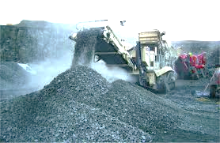
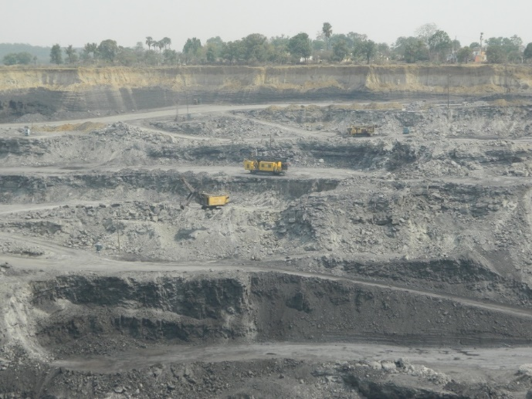
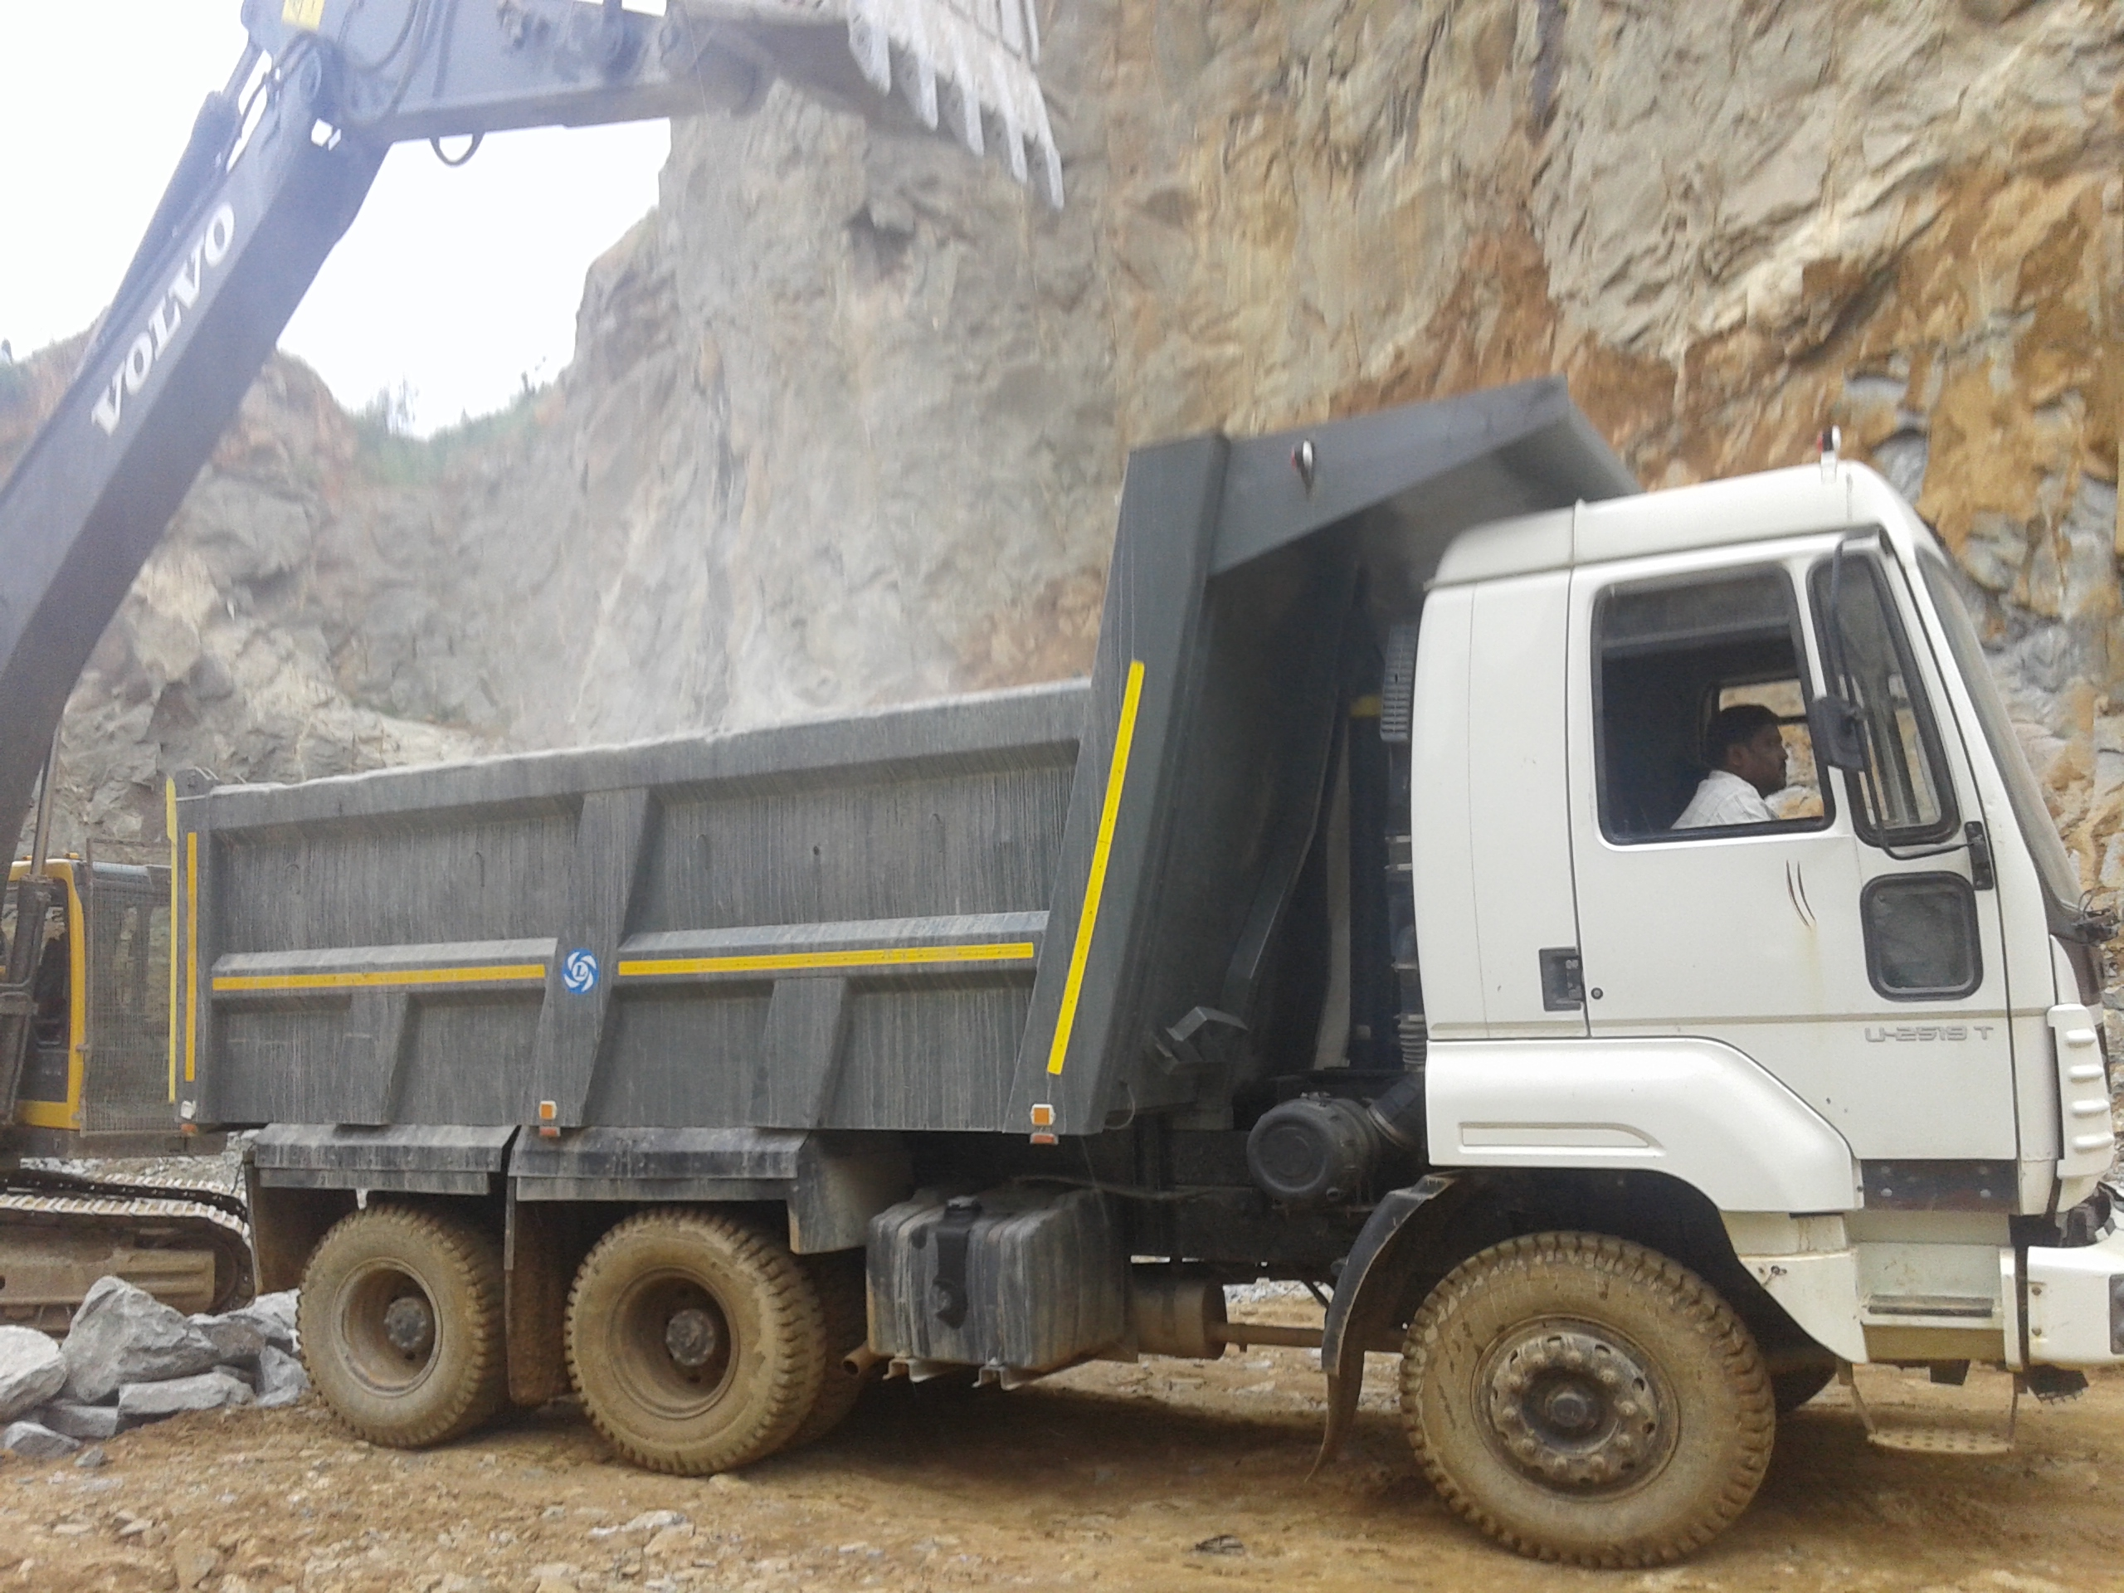
Business review Nov’22 C&M - Chennai

Slide 17
Tipper
Branch | MPB MS | 21-22 MS | For the Month |  |  |  | Cumulative
 |  |  | AL | TIV | MS | Gap | AL | TIV | MS | Gap
PME | 48% | 36% | 19 | 43 | 44% | -4% | 248 | 570 | 44% | -4%
PDP | 43% | 19% | 11 | 35 | 31% | -12% | 155 | 447 | 35% | -8%
Region 1 | 46% | 28% | 30 | 78 | 38% | -8% | 403 | 1017 | 40% | -6%
MAD | 67% | 43% | 11 | 14 | 79% | 12% | 115 | 179 | 64% | -3%
VLR | 50% | 30% | 6 | 18 | 33% | -17% | 78 | 144 | 54% | 4%
VPM | 45% | 32% | 12 | 18 | 67% | 22% | 103 | 196 | 53% | 8%
PON | 53% | 10% | 0 | 6 | 0% | -53% | 16 | 59 | 27% | -26%
Region 2 | 52% | 32% | 29 | 56 | 52% | 0% | 312 | 578 | 54% | 2%
TOTAL | 48% | 30% | 59 | 134 | 44% | -4% | 715 | 1595 | 45% | -3%

Slide 18
Heat map - YTD Nov’22
Segment | Poonamalle |  |  | Madhavaram |  |  | Padappai |  |  | Vellore |  |  | Villupuram |  |  | Pondicherry |  |  | AO Chennai
4x2 Tipper | 28.3 |  |  | 8.7 |  |  | 17.4 |  |  | 21.7 |  |  | 13.0 |  |  | 10.9 |  |  | 100.0
 | 23.1 |  |  | 50.0 |  |  | 25.0 |  |  | 60.0 |  |  | 100.0 |  |  | 100.0 |  |  | 52.2
 |  |  | 2.3 |  |  | 2.2 |  |  | 1.8 |  |  | 6.9 |  |  | 3.1 |  |  | 8.5 |  |  | 2.9
6x4 Tipper | 38.3 |  |  | 5.7 |  |  | 33.3 |  |  | 11.6 |  |  | 9.9 |  |  | 1.3 |  |  | 100.0
 | 43.3 |  |  | 20.0 |  |  | 36.9 |  |  | 46.9 |  |  | 53.6 |  |  | 44.4 |  |  | 41.3
 |  |  | 47.0 |  |  | 22.3 |  |  | 52.1 |  |  | 55.9 |  |  | 35.2 |  |  | 15.3 |  |  | 43.9
8x4 Tipper | 33.2 |  |  | 19.2 |  |  | 19.7 |  |  | 5.6 |  |  | 17.5 |  |  | 4.9 |  |  | 100.0
 | 45.0 |  |  | 84.3 |  |  | 40.3 |  |  | 54.3 |  |  | 50.0 |  |  | 22.6 |  |  | 51.9
 |  |  | 36.7 |  |  | 67.6 |  |  | 27.7 |  |  | 24.1 |  |  | 56.1 |  |  | 52.5 |  |  | 39.5
10x2 Tipper | 36.4 |  |  | 6.4 |  |  | 37.3 |  |  | 8.6 |  |  | 5.0 |  |  | 6.4 |  |  | 100.0
 | 43.8 |  |  | 21.4 |  |  | 20.7 |  |  | 78.9 |  |  | 45.5 |  |  | 0.0 |  |  | 34.1
 |  |  | 14.0 |  |  | 7.8 |  |  | 18.3 |  |  | 13.1 |  |  | 5.6 |  |  | 23.7 |  |  | 13.8
Tipper Total | 35.7 |  |  | 11.2 |  |  | 28.0 |  |  | 9.1 |  |  | 12.3 |  |  | 3.7 |  |  | 100.0
 | 43.5 |  |  | 64.2 |  |  | 34.7 |  |  | 53.8 |  |  | 52.6 |  |  | 27.1 |  |  | 44.8
 |  |  | 100.0 |  |  | 100.0 |  |  | 100.0 |  |  | 100.0 |  |  | 100.0 |  |  | 100.0 |  |  | 100.0

Slide 19
4x2 Tipper
Branch | MPB MS | 21-22 MS | For the Month |  |  |  | Cumulative
 |  |  | AL | TIV | MS | Gap | AL | TIV | MS | Gap
PME | 65% | 47% | 2 | 3 | 67% | 2% | 3 | 13 | 23% | -42%
PDP | 70% | 56% | 0 | 0 | 0% | -70% | 2 | 8 | 25% | -45%
Region 1 | 63% | 52% | 2 | 3 | 67% | 4% | 5 | 21 | 24% | -39%
MAD | 75% | 57% | 0 | 0 | 0% | -75% | 2 | 4 | 50% | -25%
VLR | 70% | 60% | 1 | 2 | 50% | -20% | 6 | 10 | 60% | -10%
VPM | 80% | 78% | 0 | 0 | 0% | -80% | 6 | 6 | 100% | 20%
PON | 85% | 83% | 0 | 0 | 0% | -85% | 5 | 5 | 100% | 15%
Region 2 | 85% | 68% | 1 | 2 | 50% | -35% | 19 | 25 | 76% | -9%
TOTAL | 77% | 56% | 3 | 5 | 60% | -17% | 24 | 46 | 52% | -25%

Slide 20
6x4 Tipper
Branch | MPB MS | 21-22 MS | For the Month |  |  |  | Cumulative
 |  |  | AL | TIV | MS | Gap | AL | TIV | MS | Gap
PME | 55% | 34% | 7 | 11 | 64% | 9% | 116 | 268 | 43% | -12%
PDP | 38% | 24% | 9 | 19 | 47% | 9% | 86 | 233 | 37% | -1%
Region 1 | 40% | 25% | 16 | 30 | 53% | 13% | 202 | 501 | 40% | 0%
MAD | 70% | 54% | 0 | 0 | 0% | -70% | 8 | 40 | 20% | -50%
VLR | 40% | 18% | 4 | 13 | 31% | -9% | 38 | 81 | 47% | 7%
VPM | 58% | 38% | 2 | 2 | 100% | 42% | 37 | 69 | 54% | -4%
PON | 45% | 20% | 0 | 0 | 0% | -45% | 4 | 9 | 44% | -1%
Region 2 | 55% | 32% | 6 | 15 | 40% | -15% | 87 | 199 | 44% | -11%
TOTAL | 45% | 27% | 22 | 45 | 49% | 4% | 289 | 700 | 41% | -4%

Slide 21
8x4 Tipper
Branch | MPB MS | 21-22 MS | For the Month |  |  |  | Cumulative
 |  |  | AL | TIV | MS | Gap | AL | TIV | MS | Gap
PME | 50% | 35% | 8 | 27 | 30% | -20% | 94 | 209 | 45% | -5%
PDP | 40% | 11% | 2 | 16 | 13% | -28% | 50 | 124 | 40% | 0%
Region 1 | 45% | 23% | 10 | 43 | 23% | -22% | 144 | 333 | 43% | -2%
MAD | 70% | 51% | 9 | 12 | 75% | 5% | 102 | 121 | 84% | 14%
VLR | 50% | 35% | 0 | 3 | 0% | -50% | 19 | 35 | 54% | 4%
VPM | 50% | 20% | 10 | 15 | 67% | 17% | 55 | 110 | 50% | 0%
PON | 35% | 2% | 0 | 6 | 0% | -35% | 7 | 31 | 23% | -12%
Region 2 | 60% | 33% | 19 | 36 | 53% | -7% | 183 | 297 | 62% | 2%
TOTAL | 52% | 27% | 29 | 79 | 37% | -15% | 327 | 630 | 52% | 0%

Slide 22
10x4 Tipper
Branch | MPB MS | 21-22 MS | For the Month |  |  |  | Cumulative
 |  |  | AL | TIV | MS | Gap | AL | TIV | MS | Gap
PME | 50% | 44% | 2 | 2 | 100% | 50% | 35 | 80 | 44% | -6%
PDP | 35% | 22% | 0 | 0 | 0% | -35% | 17 | 82 | 21% | -14%
Region 1 | 40% | 34% | 2 | 2 | 100% | 60% | 52 | 162 | 32% | -8%
MAD | 70% | 53% | 2 | 2 | 100% | 30% | 3 | 14 | 21% | -49%
VLR | 75% | 67% | 1 | 1 | 100% | 25% | 15 | 19 | 79% | 4%
VPM | 70% | 57% | 0 | 1 | 0% | -70% | 5 | 11 | 45% | -25%
PON | 50% | 0% | 0 | 0 | 0% | -50% | 0 | 14 | 0% | -50%
Region 2 | 60% | 56% | 3 | 4 | 75% | 15% | 23 | 58 | 40% | -20%
TOTAL | 40% | 38% | 5 | 6 | 83% | 43% | 75 | 220 | 34% | -6%

Slide 23
Long Haulage

Slide 24
4X2 Haulage

Slide 25
6X2 Haulage

Slide 26
8X2 Haulage

Slide 27
10X2 Haulage

Slide 28
40 TR

Slide 29
46 TR

Slide 30
55 TR

